Slide 1
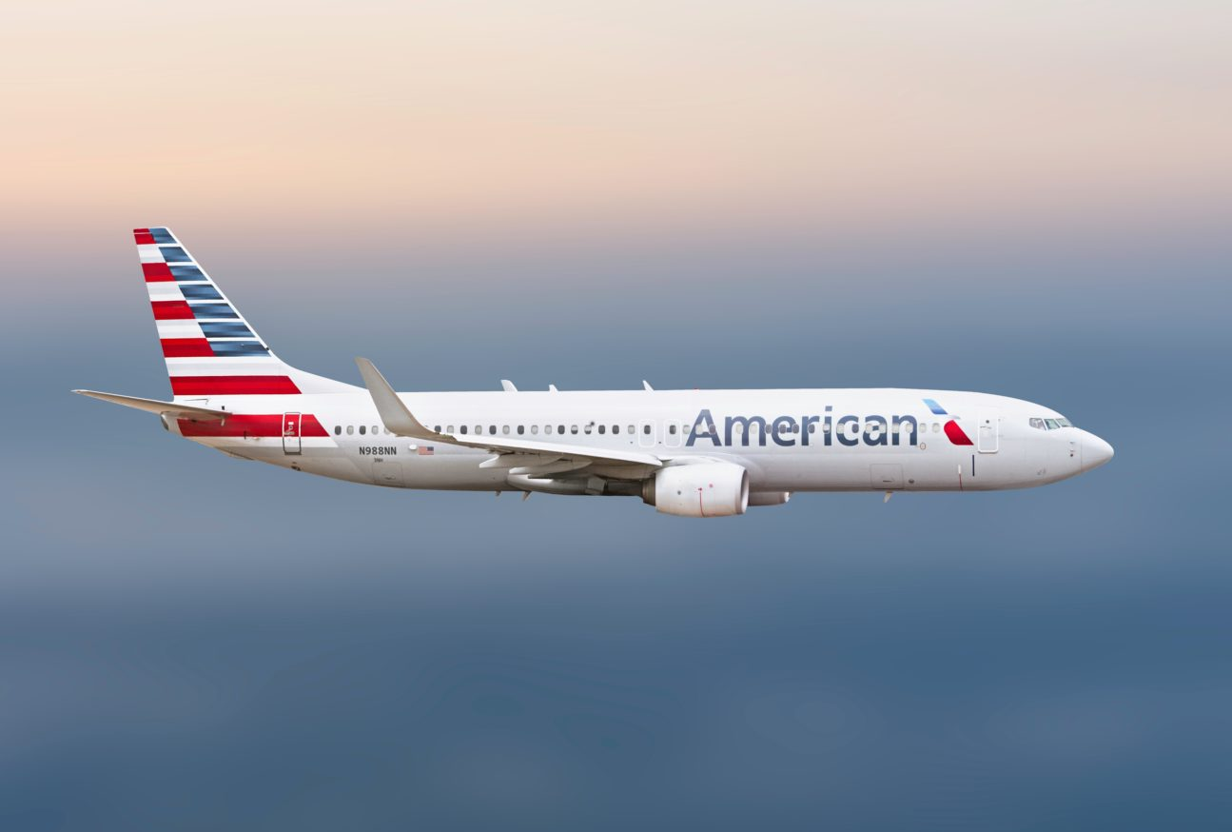
PROJECT ON – UNITED STATES AIRLINES

Slide 2
INTRODUCTION:
The Following Project is related to US Airlines.
In This Presentation we pointed-out some major insights like.
Weekday-weekend’s statistics of flights.
A major Insight in the JETBLUE Airlines.
Comparing the delays in flights by State-Wise, City-wise also checking in which weeks the delays are higher.
Statistics of No Delays in Airplane’s which are covering the longer distance range like between 2500 to 3000kms.
We have used multiple tools for Data Extracting, Data Cleaning, and using that clean data for making the Data Visualizations.
MS-Excel
MySql
Tableau
Power-Bi.

Slide 3
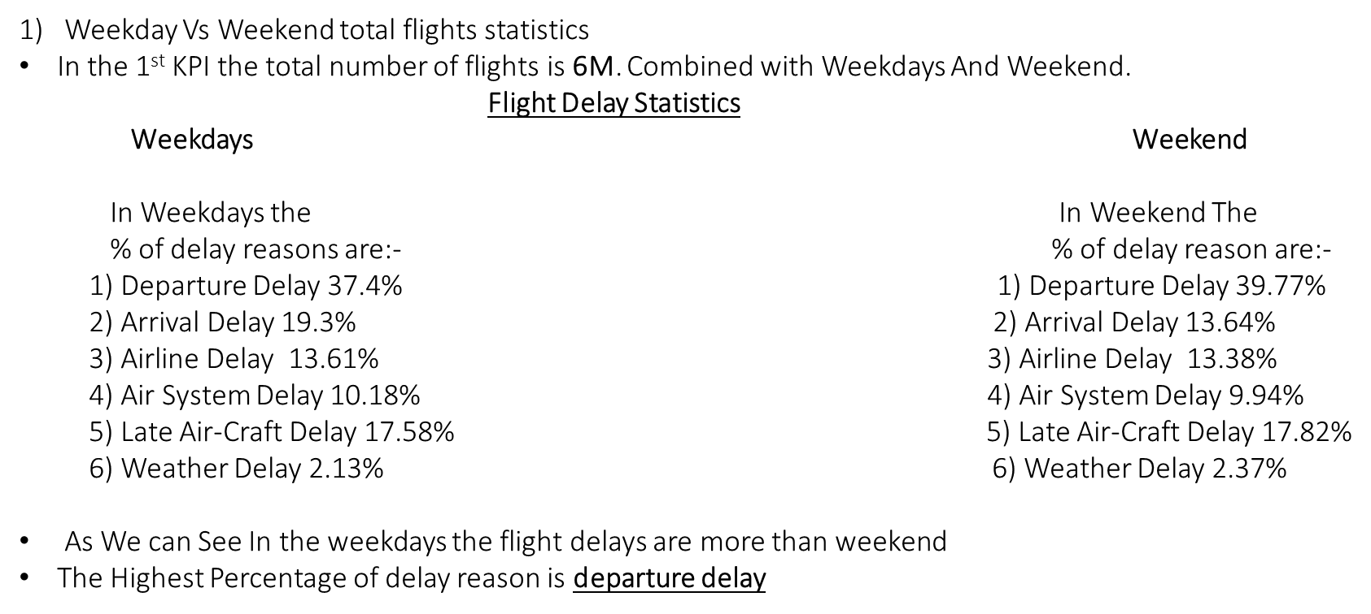
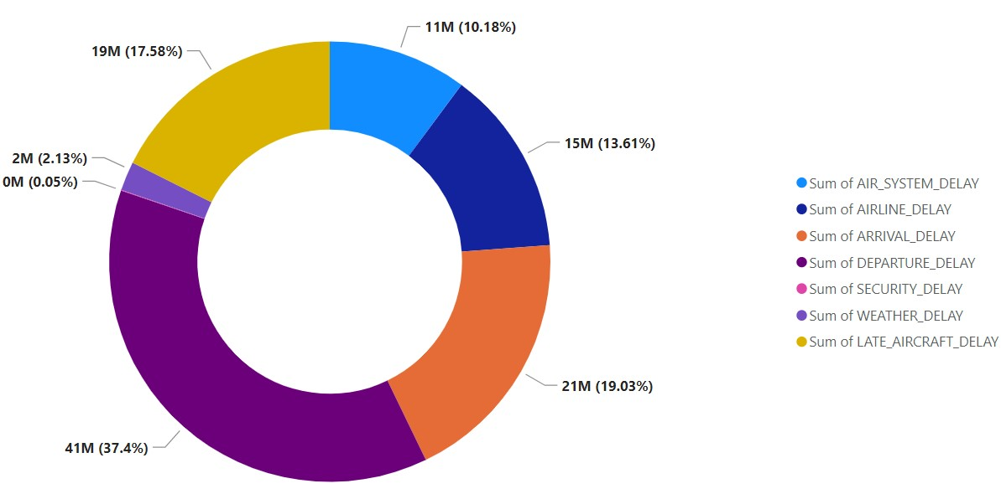
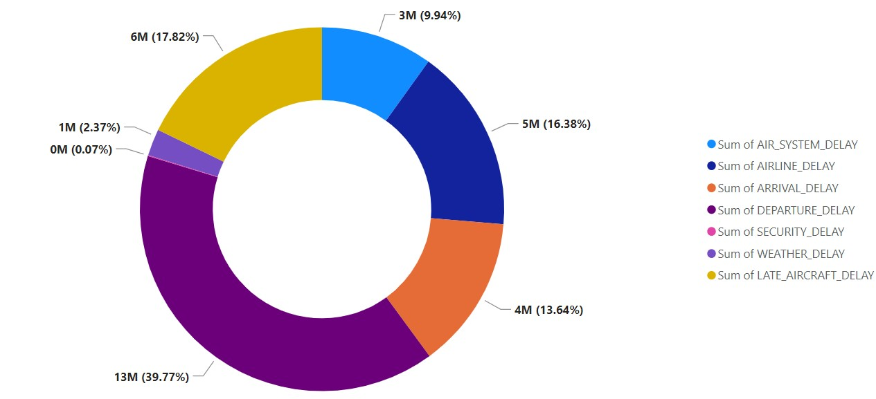
KPI-1
Weekdays
Weekend

Slide 4
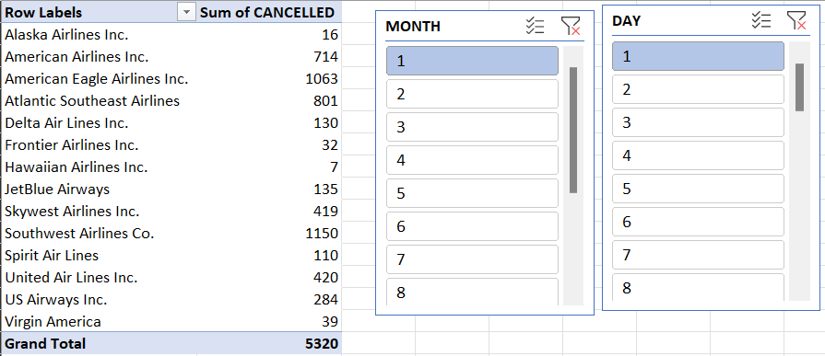
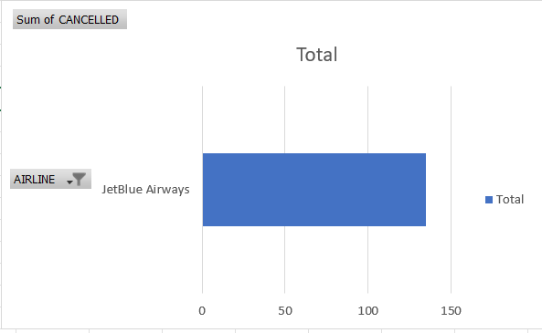
KPI-2: Total no. of cancelled flights for JetBlue Airways on First date of every month
1.As 2nd KPI denotes that the no. of flights cancelled for JetBlue Airways on first date of every month.
2.Below photo shows that how many flights are cancelled in first date of every month.
3.There are 135 flights cancelled in every first day of month.
4.The tool used in this bar graph below is excel.
5.We can edit data of the bar by selecting the graph and clicking on edit data.
6.The graph shape will automatically adjust according to the data and anytime can change the value.
7.Also we can change the colour of the bar in graph.

Slide 5
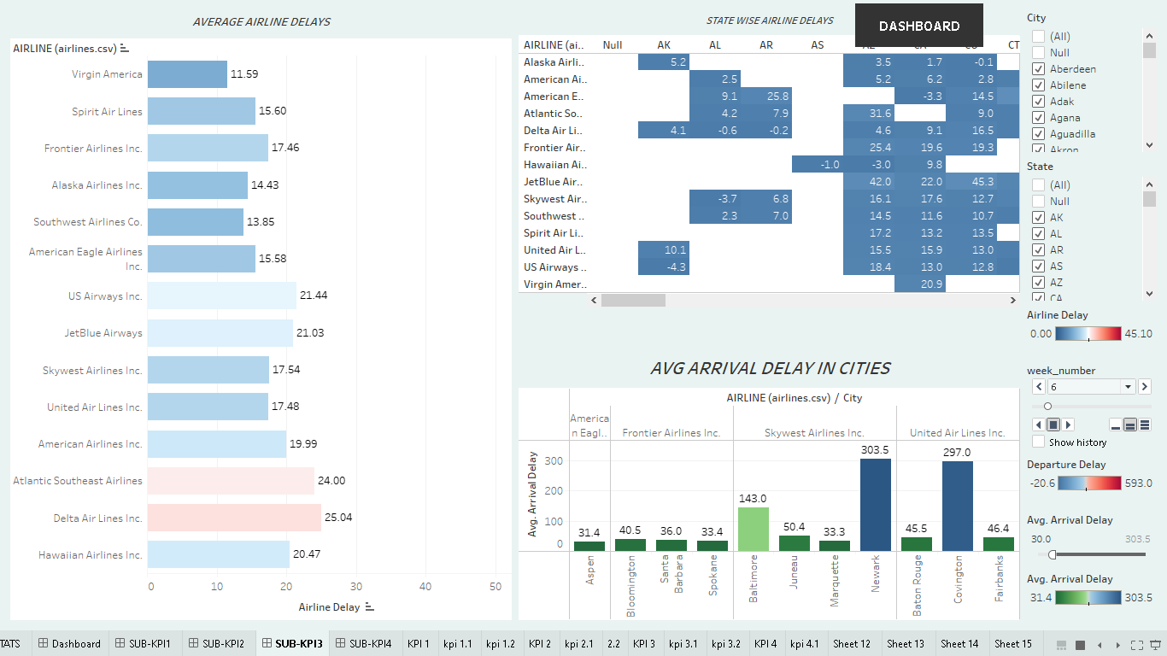
KPI-3 .State Wise Flights Delay Stat’s
TEXAS | CALIFORNIA | FLORIDA | GEORGIA | ILLUNOIS
These States have half of the Air Traffic in the Whole Country.
In the year 2015 These States had almost 2.4 Millions flights out of total 5.33 Millions .
It shows almost 48% of flights travel to these states.
These states are at TOP PRIORITY for Business, Tourism, Partying, Education as well.
Almost for every 100 flights around 15-18 flights are on or before time.
Also these states have the MAX DELAYS. Some Causes are like Weather Delays, Security Delays, Air System Delays.

Slide 6
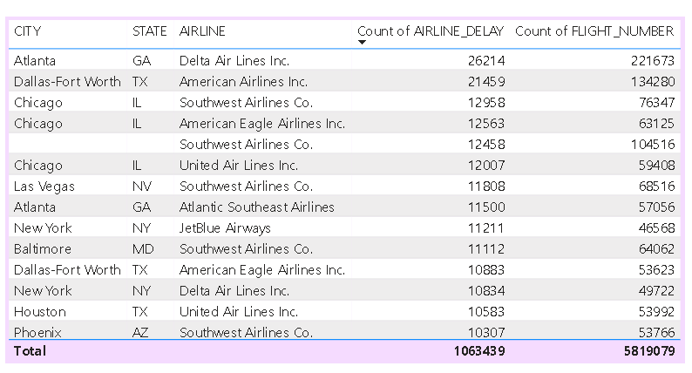
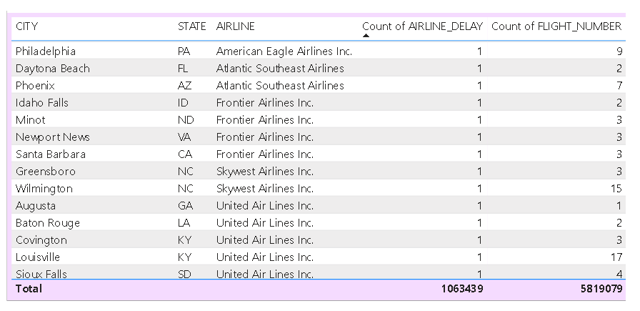
City Wise Delay Stat’s
Atlanta City Situated in Georgia had the highest number of delays.
Dallas-Fort Woth in Texas State had 2nd highest number of delays in flights.
Chicago from Illunois stands at 3rd place for Airports having highest delays.
Philadelphia from Pennsylvania has lowest delays.
Daytona beach, Idaho falls, phoenix, minot
Thou these airports had less number of flights on daily basis.

Slide 7
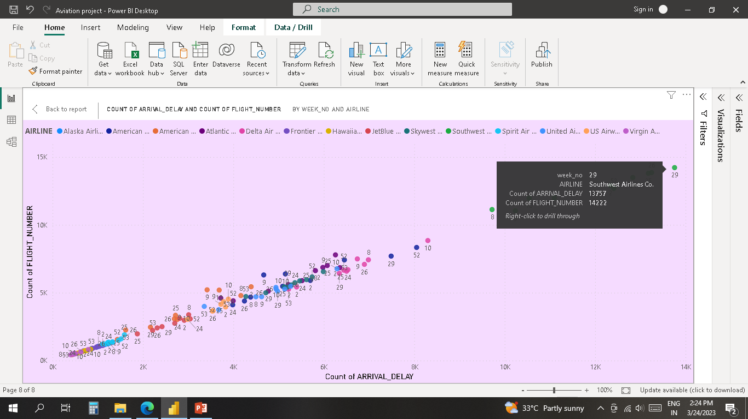
Week Wise Stat’s
SOUTHWEST AIRLINES CO. is a outlier having highest number of delays
The most delays are in the month of July, June and December.
VIRGIN AMERICA had the lowest delays compared to all the airlines.

Slide 8
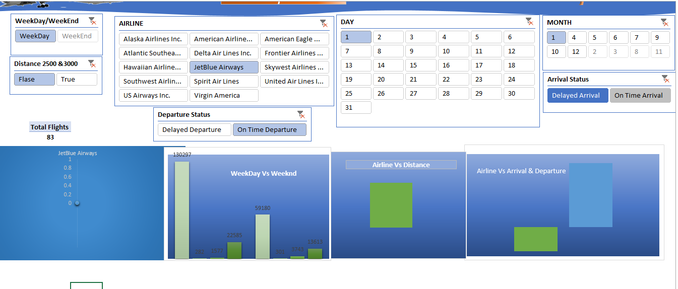
KPI-4 Number of airlines with No departure/arrival delay with distance covered between 2500 and 3000
Fourth API Say Number of airlines with No departure/arrival delay with distance covered between 2500 and 3000
We used True and False Button to filter the Flights.

Slide 9
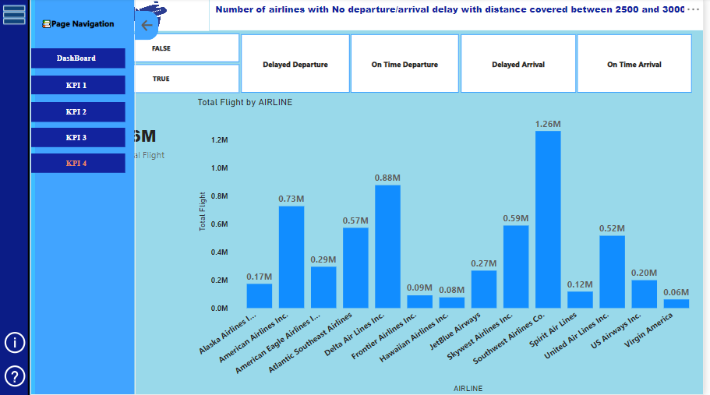
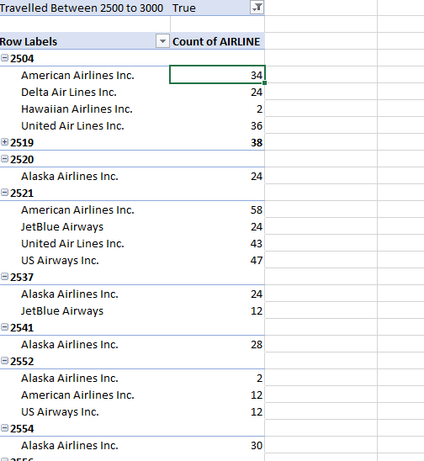
3. By clicking True Button we can able to see Number of Flights which has covered the distance between 2500 to 3000.
4. We also provided the No departure and arrival delay of Flights that we can see in the Above Picture

Slide 10
THANK YOU
TEAM MEMBERS:
MD. Tasmeem.
Suyash Pawar.
Pranali .
Omkar.
Vaibhav.

